Slide 1
Year 11 and 12
Information for Year 10 students and their parents
2021-2022

Slide 2
The Higher School Certificate
is the culmination of a student’s school career
is the highest educational award that can be achieved at secondary school in NSW
reports student achievement in terms of a standard achieved in individual courses
presents a profile of student achievement across a broad range of subjects
Notes:
Students may accumulate course units towards the HSC for a period of up to 5 years.
Students may choose to undertake this ‘pathway’ approach for a variety of reasons including:
commitments outside school - part time work, elite sportsperson etc.
apprenticeship or traineeship
acceleration
repeating
http://ace.bostes.nsw.edu.au/ace-8036
http://educationstandards.nsw.edu.au/wps/portal/nesa/11-12/hsc/subject-selection

Slide 3
HSC Course Structure
All courses in the HSC have a unit value
Most courses are 2 units which equates to 120 hours of study and a HSC result out of 100
  Some courses are 1 unit. This is equivalent to 60 hours of study and a HSC result out of 50
Many 1 unit courses are extension courses, enabling 3 or 4 units of a course to be studied
  At Cheltenham 2 units = 7 lessons / cycle
  1 unit = 4 lessons / cycle

Slide 4
Requirements for the HSC
Year 11
minimum of 12 units
students must satisfactorily complete the Year 11 course before commencing the corresponding Year 12 course
Year 12
minimum of 10 units
Notes:
Students may accumulate course units towards the HSC for a period of up to 5 years.
Students may choose to undertake this ‘pathway’ approach for a variety of reasons including:
commitments outside school - part time work, elite sportsperson etc.
apprenticeship or traineeship
acceleration
repeating
http://ace.bostes.nsw.edu.au/ace-8036
http://educationstandards.nsw.edu.au/wps/portal/nesa/11-12/hsc/subject-selection

Slide 5
Requirements for the HSC
Both the Year 11 and Year 12 pattern of study must include:
2 units of compulsory English
at least 6 units of Board Developed Courses
at least 3 courses of 2 units value or greater
at least 4 subjects (including English)
a maximum of 6 units of Science may be included in the Year 11 pattern of study.
a maximum of 7 units of Science may be included in the Year 12 pattern of study.
Notes:
English is mandatory for the HSC.
English Studies and Mathematics Standard 1 are Board Developed Courses with an optional HSC examination. Students who choose English Studies and/or Mathematics Standard 1, but wish to receive an ATAR, must undertake the optional examination.
Extension course are not separate subjects. E.g. Advanced English (2 units) + Extension 1 (1 unit) + Extension 2 (1 unit) = 4 units but only 1 subject.
At most, 6 units of courses in Science can be included in the pattern of study for Year 11. However, from 2019 Year 12, this increases to 7 units of Science, to allow for the study of Science Extension.

Slide 6
Requirements for the HSC
– meeting the minimum standard in literacy and numeracy
From 2020, students need to demonstrate they have met a minimum standard in literacy and numeracy to be eligible for a HSC.
Students will show they meet the HSC minimum standard by passing online tests of basic literacy and numeracy skills, which are available for them to sit when they are ready in Year 10, 11 and 12 and after the HSC.

Slide 7
HSC: All My Own Work
  HSC: All My Own Work is a mandatory program designed to help HSC students to follow the principles and practices of good scholarship.
  It consists of five modules:
    Scholarship Principles and Practices
    Acknowledging Sources
    Plagiarism
    Copyright
    Working with Others
Notes:
Students must complete HSC: All My Own Work or its equivalent before they can be enrolled for any Preliminary or HSC course with NESA via Schools Online.
Only students entered for Stage 6 Life Skills courses are exempt from this requirement.
The HSC: All My Own Work program is integrated with other NSW syllabuses and programs. The program is designed to be delivered flexibly as self-paced learning modules.
The program is available on the NESA Website: http://educationstandards.nsw.edu.au/wps/portal/nesa/11-12/hsc/hsc-all-my-own-work

Slide 8
Types of HSC Courses
Board Developed Courses | Board Endorsed Courses
HSC examination except for: optional examination in English Studies and Mathematics Standard 1 and VET Curriculum Framework courses all Life Skills courses | No HSC examination – school-based assessment only
May be included in the calculation of a student’s Australian Tertiary Admission Rank (ATAR). | Not included in the calculation of a student’s Australian Tertiary Admission Rank (ATAR).
Includes some Vocational Education and Training (VET) courses. | Includes some Vocational Education and Training (VET) courses.
Includes Life Skills courses.
Notes:
Board Developed Courses are developed by NESA and all students in the state study the same course content and complete the same HSC examination. These courses may contribute to the calculation of a student’s ATAR . Life Skills Courses do not have an examination and are not included in the calculation of an ATAR.
Board Endorsed Courses have syllabuses endorsed by NESA to cater for a wide candidature in areas of specific need not served by Board Developed Courses. These courses may offer an alternative career path for students.

Slide 9
Board Developed Courses and the ATAR
Category A Courses | Category B Courses
May be included in the calculation of a student’s Australian Tertiary Admission Rank (ATAR) | No more than 2 units of Category B courses can be included in the calculation of a student’s ATAR
Compulsory HSC Examination for most courses | Optional HSC examination for some courses
 | Include VET Curriculum Framework courses and have compulsory work placement.
Notes:
It is the responsibility of the Universities Admission Centre (UAC) to determine if a course can be included in the calculation of the ATAR.
Category A Courses have academic rigour and depth of knowledge to provide background for tertiary studies. Examples include Biology and Geography.
Category B Courses - no more than two units of Category B courses can be included in the ATAR calculation. Examples include Human Services and Hospitality.
Course category listings available at the UAC Website: http://www.uac.edu.au/documents/undergraduate/HSCcourses.pdf

Slide 10
EXTENSION COURSES
Extension Courses build on the content of the corresponding 2 unit course
Both English and Mathematics have Preliminary (Year 11) Extension courses
In each of English and Mathematics you may choose One or Two unit HSC (Year 12) extension courses
One unit HSC (Year 12) Extension Courses are also offered in History, Japanese, Music and Science (by application only).

Slide 11
VET & EVET Courses
Vocational Education and Training Courses are either Board Developed or Board Endorsed Courses. They are called VET when run at school and EVET when run externally ie TAFE.
VET courses offered on site at CGHS are:
  Financial Services (Board Developed -Category B course)
  Sport Coaching (Board Endorsed course)
There are numerous EVET courses.
VET and EVET Courses in the Curriculum framework are Category B courses. If a student chooses to undertake a written exam the course can be included in the calculation of the ATAR.
No more than TWO category B units can be included in the ATAR calculation.

Slide 12
External Providers
An application is required to be considered to study with any of these providers
The NSW School of Languages – Mrs Weir
Sydney Distance Education – Mrs Weir
TAFE – Mrs Lake/Mrs Spring
Saturday School of Community Languages – Mrs Bhoyroo
Outside Tutor
Private Providers
Notes:
First step is to collect an external providers application form (outside the HT Wellbeing office ) or print one off from TEAMs under the External course channel. The school based application form needs to be complete and handed to their YA by the close of subject selection (Subject Selection will close online MONDAY 27th of JULY at 3 pm)
If they are interested in an external course they should speak to the coordinators listed to discuss the requirements involved and courses available.
School is limited to 6 places for study at the NSW school of languages and SDE

Slide 13
Other Useful Resources
Students have been issued with their University Entry requirements 2023 booklets through their careers lesson. You can also download it from the UAC website or our school website.
UAC Subject Compass
https://www.uac.edu.au/future-applicants/subject-compass
NESA subject selection
https://educationstandards.nsw.edu.au/wps/portal/nesa/11-12/hsc/subject-selection

Slide 14
HSC example – subjects & courses
English Advanced(2u) +HSCExtension1(1u) +HSC Extension 2(1u)
Mathematics Advanced(2u) +HSC Extension 1(1u)
Modern History(2u) +HSC Extension (1u)
Total units = 10
IS THIS PATTERN OF STUDY ACCEPTABLE for HSC?
Notes:
NO – 3 subjects

Slide 15
HSC example – subjects & courses
English Advanced(2u)
Earth and Environmental Science (2u)
Biology (2u)
Chemistry (2u)
Physics (2u)
Total units = 10 units
IS THIS PATTERN OF STUDY ACCEPTABLE for HSC?
Notes:
No- more than 7 units of Science

Slide 16
HSC example – subjects & courses
English Standard(2u)
Mathematics Standard(2u)
Biology (2u)
Food Technology (2u)
PDHPE (2u)
Total units = 10 units
IS THIS PATTERN OF STUDY ACCEPTABLE for HSC?
Notes:
YES

Slide 17
HSC + the ATAR

Slide 18
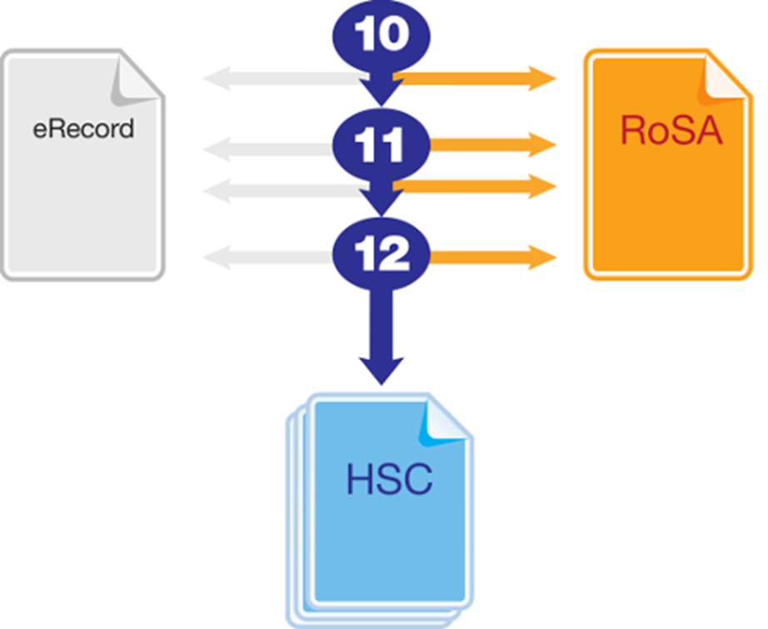
Record of School Achievement
Notes:
Eligible students who leave school before receiving their Higher School Certificate (HSC) will receive the NSW Record of School Achievement (RoSA).
The RoSA is a cumulative credential in that it allows students to accumulate their academic results until they leave school.
The RoSA records completed Stage 5 and Preliminary Stage 6 courses and grades, participation in any uncompleted Preliminary Stage 6 courses and HSC results for students who have not completed their HSC
It is of specific use to students leaving school prior to the HSC.
http://educationstandards.nsw.edu.au/wps/portal/nesa/11-12/leaving-school/record-of-school-achievement
https://studentsonline.bostes.nsw.edu.au/go/seniorstudy/

Slide 19
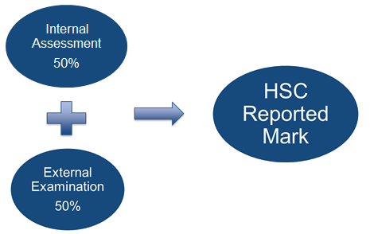
How is the HSC Mark Determined?

Slide 20
The HSC report – it’s all about STANDARDS
You have two calibrated marks for each of your courses;
(moderated) school assessment mark
examination mark
Both of these reflect your performance in relation to the course standards.
These two marks are averaged – the result is your HSC mark
Course School Exam HSC Standard
mark mark mark achieved
English Advanced 70 68 69 3
Mathematics 78 82 80 5
Economics 77 75 76 4
French 64 68 66 3
Visual Arts 84 78 81 5

Slide 21
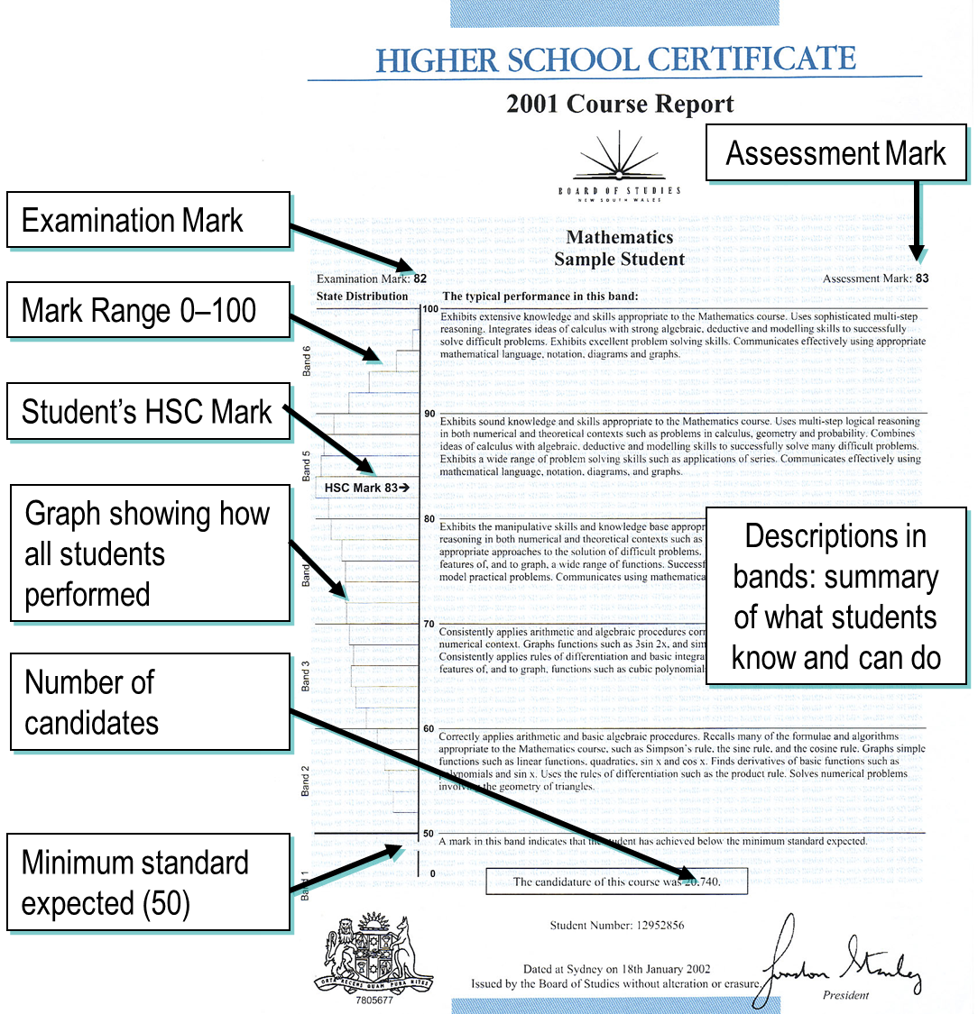

Slide 22
Australian Tertiary Admission Rank
The Australian Tertiary Admission Rank (ATAR):
    is for students wishing to gain a place at a university
    is a RANK NOT a mark – a number represents a rank between 0.00 and 99.95
    (only ATARs above 30 are reported)
    provides information about how a student performs overall in relation to other students of their cohort
Notes:
UAC will only consider Board Developed Courses in the calculation of the ATAR.
The ATAR provides the discrimination required by universities for the selection process.

Slide 23
ATAR Eligibility
To be eligible for an ATAR a student must have satisfactorily completed at least 10 units of ATAR courses, including at least:
  eight units of Category A courses i.e. maximum of 2 Units of Category B (such as Hospitality, Entertainment)
  two units of English
  three courses of two units or greater
  four subjects

Slide 24
Urban Myths
It is better to choose “hard” courses.
It is better to choose “easy” courses.
Answer- there are no hard or easy courses - they all contain a lot of detail and therefore are all hard
It is impossible to get a high ATAR if you take a VET course or English Standard or Mathematics General.
Answer- Students who have completed these courses and their ATAR
English Standard 99.40
Mathematics General 2 99.65 (now called Mathematics Standard 2)
Senior Science 99.95 (course no longer offered for the HSC)
Textiles & Design 99.45
(Data from Scaling report 2018 page 33-35)

Slide 25
Urban Myths
You have to do chemistry or physics to get a good ATAR
Answer – if you are not good at science or do not like science you will not do well in science
If you are from a particular culture you can do Mathematic Ext 2
Answer – Maths Ext 2 does not discriminate on culture. If you are poor at maths it does not matter what culture you come from

Slide 26
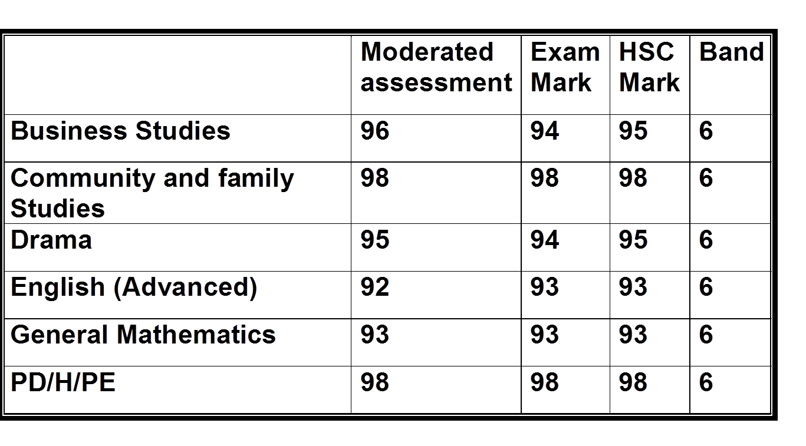
ATAR =99.1
A real CGHS student

Slide 27
ATAR =99.3
A real CGHS student
 | Moderated Assessment | Exam Mark | HSC Mark | Band
Ancient History | 97 | 97 | 97 | 6
Drama | 93 | 94 | 94 | 6
English (Advanced) | 92 | 93 | 92 | 6
Society & Culture | 96 | 96 | 96 | 6
Textiles & Design | 98 | 98 | 98 | 6

Slide 28
So HOW do I get a good ATAR?
By working hard . . . and doing well in all your courses
A 90 is a 90 is a 90 - regardless of the course
If you pick subjects above your ability and you struggle in those courses - You will not do well and this course will drag you down.
You DO NOT get “scaled up” just because you select Physics or Mathematics EXT 2.
Having to spend all day at school and then attend hours of tutoring in a subject you are struggling with will not enable you to do well. It will only increase anxiety and stress.

Slide 29



Resources available on our website
UAC - University Entry Requirements 2023 Year 10 Booklet
UAC – All about the ATAR
UAC Scaling Report HSC 2019

Slide 30
How to choose?

Slide 31
Course Selection Considerations
Abilities
Interests/Motivation
Career aspirations and needs
Syllabus requirements - Practical/Major work components
Subject combinations
Other commitments
Ask for advice from:
      teachers
      parents
      Year adviser
      careers adviser
Notes:
Abilities - choose subjects where you are capable of doing well (Teacher recommendations for English and Mathematics have gone home earlier this week via a letter to your daughter)
Interests/Motivation- choose subjects that interest you.
Career aspirations and needs - keep in mind future career paths but be realistic about choices.
Syllabus Requirements – be mindful of how many practical works and major works are required for your pattern of study and the timing of submission.
Subject combinations - do the subjects complement each other?
Other commitments - when choosing subjects, it its important to balance study with outside commitments and influences such as work, sport and family.

Slide 32
Subject selection interviews
On Wednesday 1st of July we are offering interviews ONLY to students who are struggling to decide their subjects and would like to discuss their options. Interviews will take about 10 minutes.
They are optional – need to put name in booking form in General tab of TEAMs by this Friday
Parents can not attend due to COVID restrictions still in place at schools.
Notes:
The interviews are not about specific subjects. If they have specific subject questions please post a question through TEAMs or see the relevant Teacher at school.
ALL students pattern of study once submitted (at close of subject selections online) will be reviewed to check for eligible for the HSC and the ATAR. We will also discuss with students any concerns we have ie can they handle 3 major project subjects (have they displayed in the past organisational skills).

Slide 33
Subject Selections are due:
Electronically via the Web Preferences online site. Student have been given their own individual passwords for this website. This will open tomorrow.
All selections are DUE AT THE LATEST by
    Monday 27th July 2020
This is a NOT first in best dressed. All subjects are open to everyone up until 3.00pm on 27th July 2020.
Notes:
They will need to PRINT out a receipt, this must be signed and returned to school no LATER than Tuesday 28th of July.

